Slide 1

IOT BASED SMART WASTE MANAGEMENT SYSTEM
DEPARTMENT OF ELECTRONICS AND COMMUNICATION ENGINEERING
Guide by:
Asst Prof.Mr.P.DHANASEKARAN.,M.E
Presented by:
AVINASH.G
PRAKASH.D
RANJITH KUMAR.R

Slide 2

OBJECTIVE
To design a “Smart Dustbin” which is a wifi enabled bin which automatically detects the garbage level and sends message to respective municipal authorities updating the status of the bin.
The salient feature of this method is to build a clean environment and to empower the “SWACHH BHARATH” Mission.

Slide 3
ABSTRACT
In this system, smart bin is built with a pic microcontroller, which is interfaced with wifi module and sensor network (Ultrasonic,MQ6,LM-35,LDR), Once the garbage reaches the threshold level sensor will trigger the Microcontroller. This system also includes GAS sensor (MQ6) for measuring the various gas level from dust bin as well as environment. Once these smart bins are implemented by replacing our traditional bins that present today, we had an opportunity to bring clean environment from lumping of wastes on roadside.

Slide 4
LITERATURE REVIEW
An IoT based Smart Garbage Alert System.
A low-cost IoT based Environmental Monitoring System.
IoT based intelligent garbage monitoring system.
IoT garbage monitoring system.
Smart Garbage Monitoring System using Internet of Things (IOT).

Slide 5
PROPOSED SYSTEM
In the proposed method, a Sensor node is installed in every Smart-bin with a power supply. The Sensor node senses bin fullness, temperature, air quality readings and sends statuses by using wifi module, additionally air quality of the area around two meters are measured and displayed and LED setup is fixed around the dustbin to visible at night times, The following hardware components are fixed to the bin. It can also update the status instantly and sends this information to its nearest corporation office. An effective HTML based webpage is used to get the status in the office.

Slide 6
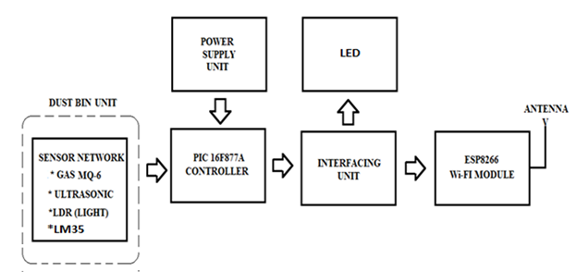
BLOCK DIAGRAM

Slide 7
LIST OF HARDWARE COMPONENTS
PIC 16F877A CONTROLLER
ESP8266 WIFI-MODULE
MQ-6(GAS SENSOR)
ULTRASONIC SENSOR
LDR(LIGHT DEPENDENT RESISTOR)
POWER SUPPLY UNIT
LED
LM35(TEMPERATURE SENSOR)

Slide 8
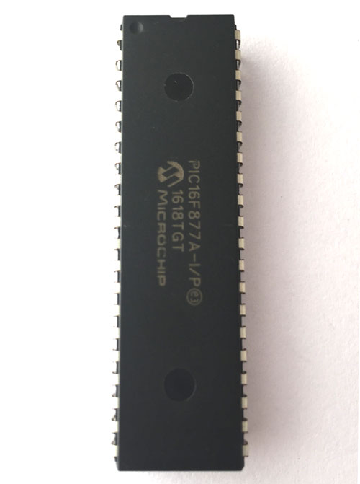
PIC 16F877A CONTROLLER
Bus width - 8 bits
Pin Count - 40
Program Memory - 14.3 kb
CPU Speed - 5 million instructions per second
RAM Size - 368 bytes
EEPROM Size - 256 bytes

Slide 9
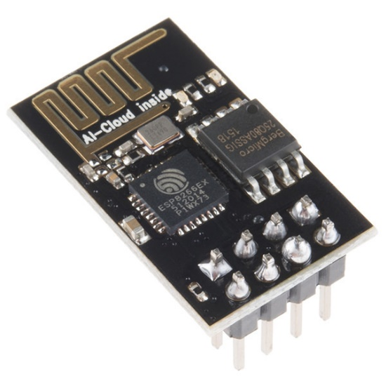
ESP8266 WIFI-MODULE
802.11 b/g/n.
Frequency range : 2.4GHz - 2.5GHZ.
Operating voltage : 3.0v~3.6v.
Operating current: Average value 80mA.

Slide 10
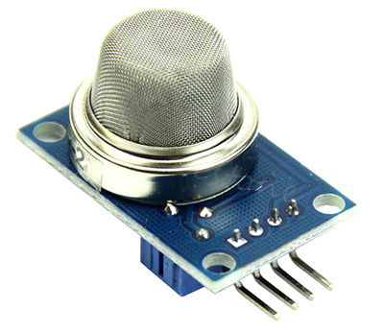
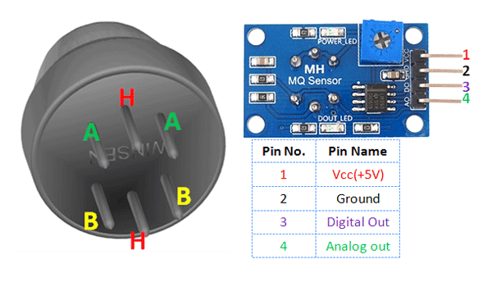
MQ-6(GAS SENSOR)
Sensitivity to LPG, iso-butane, propane, alcohol, smoke
Detection Range: 100 - 10,000 ppm
Fast Response Time: <10s
Voltage: 5.0V

Slide 11
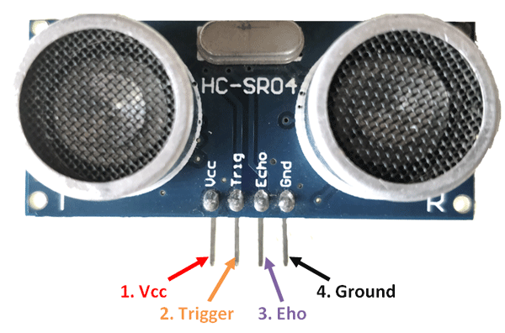
ULTRASONIC SENSOR
Detecting range: 3cm-4m
30 degree angle
Supply voltage: 5 v
Ultrasonic Frequency: 40k Hz
Trigger Pulse Width :10 μs

Slide 12
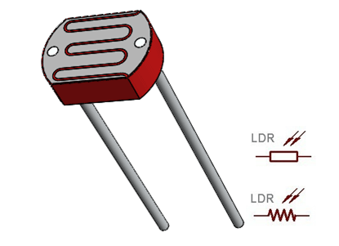
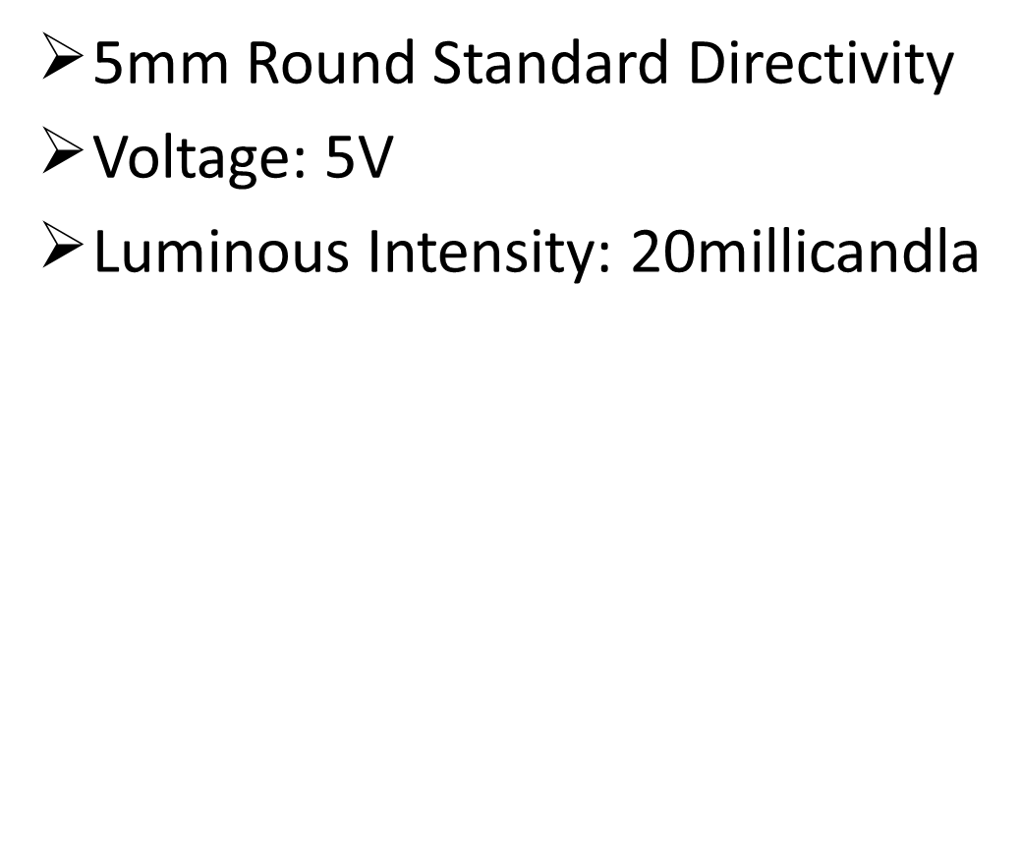
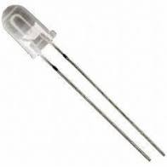
LDR
Max power dissipation: 200mW
Peak wavelength: 600nm
LED

Slide 13
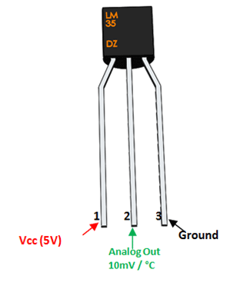
LM-35
Measure temperature ranging from -55°C to 150°C
Voltage: 5V
±0.5°C Accuracy

Slide 14
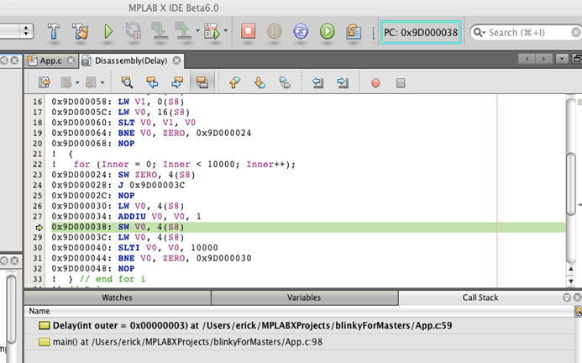
SOFTWARE COMPONENTS
MPlab IDE platform

Slide 15
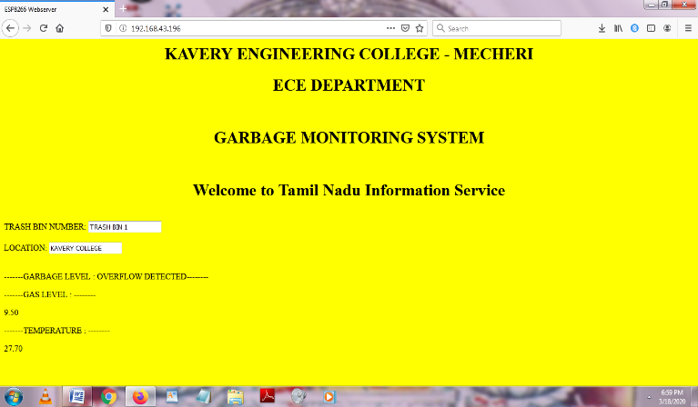
RESULT

Slide 16

ADVANTAGES
A reduction in manpower, emissions, fuel use and traffic.
Minimize the number of waste bins needed.
Improved environment (no overflowing bins and less unpleasant smell).

Slide 17
APPLICATIONS
Real time based cleaning of our cities.
Empowered Swachh Bharat Mission.
Used in public areas like bus stands, railways stations, etc…
Used in industries to deliver waste at proper timing.

Slide 18

FUTURE SCOPE
The system will develop the recycling (burning process for converting the waste into heat energy i.e., power generator or fertilizer) the wastage of the dust within the unit.

Slide 19
CONCULSION
The proposed system uses a more powerful and efficient microcontroller and the data is uploaded to the database only when leftover space and garbage weight in the garbage container cross thresholds. The collected data is stored in the cloud and can be used for predicting the waste generation. The automated execution of commands and triggering helps in providing exact values of the garbage levels resulting in efficient garbage collection and monitor.

Slide 20

ANY QUERIES

Slide 21



